Slide 1


Ant Colony Optimization Scheduling
By: Jaouaher Belgacem
18.11.2022
Notes:
In meiner heutigen Präsentaiton werde ich meine Bachelorarbiet zum Thmea … Vorstellen.

Slide 2
Motivation
Why Ant Colony Optimization?

Slide 3
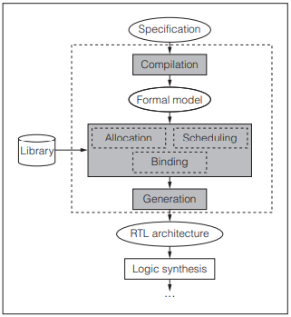
1
Ant Colony Optimization Scheduling
Introduction
What is HLS?
[1]

Slide 4

2
Introduction
What is a Hardware/Software Codesign?
sums up in putting the effort of designing both hardware and software elements in a collaborating way into one single design.

Slide 5
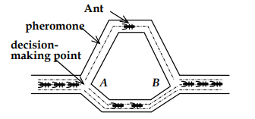
3
Foundations
ACO:

Slide 6
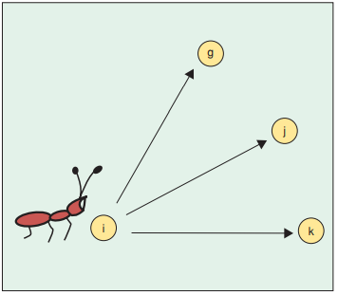
4
Foundations
TSP problem and ACO:

Slide 7
5
Foundations
ACO Rules:
Updating pheromone
The movement of Ants
Initialization of the pheromone Trail
Stopping rule

Slide 8

6
Model and verfiy concurrent systems using the theory of „Communicating Sequential Processes (CSP)“
Foundations
ACO algorithm flow:
18.11.2022

Slide 9
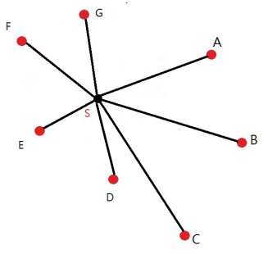
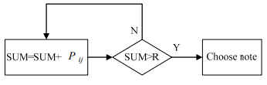
7
Foundations
ACO path possibilities:
18.11.2022

Slide 10
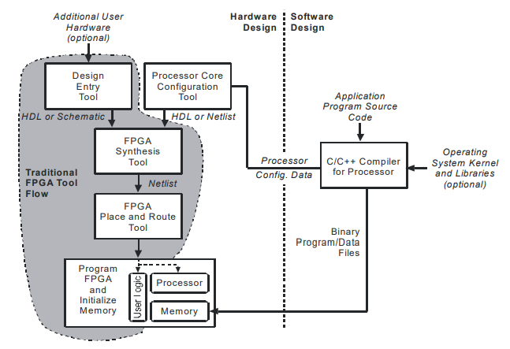
8
ACO and HLS integration
SOPC
18.11.2022

Slide 11
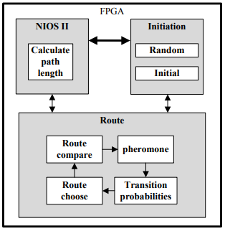
8
ACO and HLS integration
FPGA mapping

Slide 12
Conclusion

Slide 13
Thank You!
Notes:
Damit bin ich am Ende meines Referates. Ich danke Ihnen für Ihre Aufmerksamkeit.

